Slide 1
Date : 2012/12/20
Author : Rajvardhan Patil, Zhengxin Chen
Source : KEYS’12
Speaker : Er-Gang Liu
Advisor : Dr. Jia-ling Koh

Slide 2
Outline
Introduction
High level Architecture
Query Parsing
Delimiters
CFG Grammar
SQL Query Construction
Grouping Algorithm
Constructing SQL Clauses
Experiment
Conclusion

Slide 3
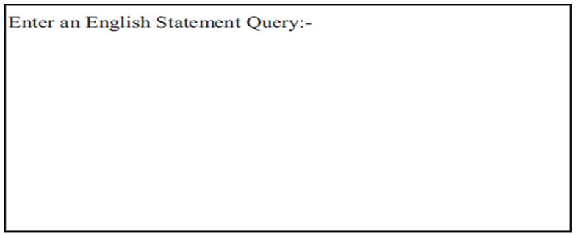
Introduction
Keyword Search
English Language Query
System Interface
Notes:
希望User 輸入 英文句子 別於其他都用keyword search
目的 輸入一般句子 自動產生SQL 找出結果
把一般的英文句子 視為 拆解成Sub Query
一句話 意圖有好幾個意圖 想找的條件

Slide 4
Introduction - Overview
Break the query into sub-queries
Query: Find a Honda car which is Civic in model and mileage greater than 20 or has price less than 15000 or manufactured in year 2000.
SQ-1: Find a Honda car
SQ-2: Civic in model and mileage greater than 20 or
SQ-3: price less than 15000 or manufactured in year 2000
Parenthesize Query
( (car = Honda) and ( ( (model = civic) and (mileage > 20 ) )
or ((price < 15000) or ( year = 2000) ) ) )
Notes:
Sub Query 在轉成各個條件 , 對應的屬性和Value 邏輯的組合
想找的欄位和Value Logical Operator , 更能表示使用者的搜尋意圖. 更多的資訊去判別
這篇的概念 分成Sub-Query , 介係詞 來幫助切斷 , 著重在句子的拆解 去反應User要的資訊

Slide 5
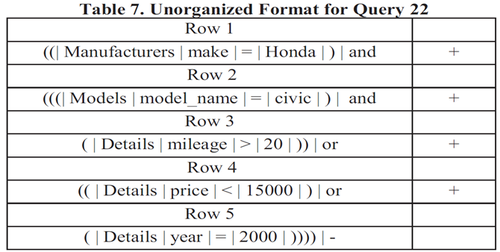
Introduction
Unorganized format
SQL format

Slide 6
Outline
Introduction
High Level Architecture
Query Parsing
Delimiters
CFG Grammar
SQL Query Construction
Grouping Algorithm
Constructing SQL Clauses
Experiment
Conclusion

Slide 7
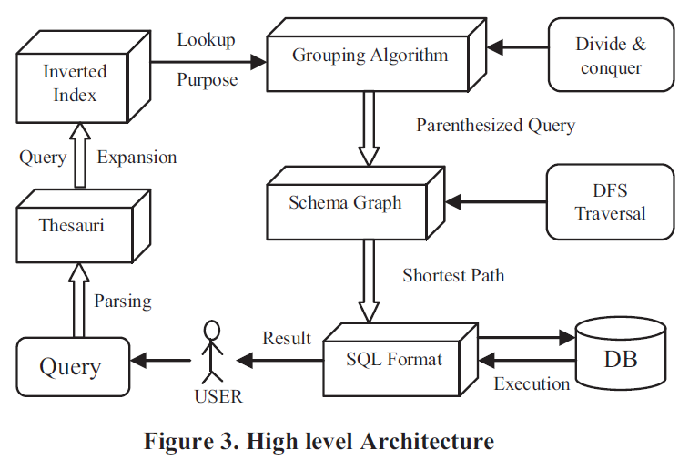
High Level Architecture
Notes:
先建
Value 和 欄位 先建立Index
欄位字典

Slide 8
Outline
Introduction
High Level Architecture
Query Parsing
Delimiters
CFG Grammar
SQL Query Construction
Resolving Ambiguity
Grouping Algorithm
Constructing SQL Clauses
Experiment
Conclusion

Slide 9
Query Parsing
An English user query comes with a subject and a predicate.
The subject is the information that the user is looking for.
The predicate tells us something about the subject’s requirement with the help of sub-queries (SQ).
Query : A Toyota car having Red color and production year > 2000 or giving mileage of 30 miles per gallon.
Subject: A Toyota car
SQ 1: Red color and production year > 2000 or
SQ 2: mileage of 30 miles per gallon
Notes:
謂語與主語相對，兩者是陳述與被陳述的關系。謂語則用來對主語或主詞加以陳述 ,來說明主語「是什麼」、「做什麼」或「怎麼樣」。
EX：
在「這個球是黃色的」這句中，「這個球」是主詞，「是」字是謂語，「黃色的」是表語。
在「他正在打籃球」這句中，「他」是主詞，「正在打」是謂語，「籃球」是賓語。

Slide 10
Query Parsing - Delimiters
Delimiter：Delimiters are the words used by the user to connect different sub-queries formulating into a query
Gerunds (動名詞)
Verb
Interrogative and relative pronoun (疑問句,關係代名詞)
Prepositions(介系詞)
Gerunds (動名詞)：
Query : A Toyota car having Red color and production year > 2000 or giving mileage of 30 miles per gallon.
Subject: A Toyota car
SQ 1: Red color and production year > 2000 or
SQ 2: mileage of 30 miles per gallon
Verb ：
Query : Check for the Students getting GPA < 3.0 and were absent for more than 10 days.
Subject: Check for the Students
SQ 1: GPA < 3.0 and
SQ 2: absent for more than 10 days

Slide 11
Query Parsing - Delimiters
Interrogative and relative pronoun (疑問句,關係代名詞)：
Query : Find a car which is red in color and price < $3000 or whose mileage > 20
Subject: Find a car
SQ 1: red in color and price < $3000 or
SQ 2: mileage > 20
Prepositions(介系詞)：
Query : Look for a book by author xyz or abc with pages no less than 100
Subject: Look for a book
SQ 1: author xyz or abc
SQ 2: pages no less than 100

Slide 12
Outline
Introduction
High Level Architecture
Query Parsing
Delimiters
CFG Grammar
SQL Query Construction
Grouping Algorithm
Constructing SQL Clauses
Experiment
Conclusion

Slide 13
Query Parsing – CFG Grammar
STRUCT makes use of a CFG grammar to interpret the user submitted English queries.
Query : find Honda or Toyota cars with 2 doors and Color Red or which give mileage greater than 20 miles per gallon.
Discarding non-essential information:
Resulting Query : Honda or Toyota cars with 2 doors and Color Red or which mileage > 20
Subject: Honda or Toyota cars
Predicate: 2 doors and Color Red or which mileage > 20
Sub-query 1: 2 doors and Color Red or
Sub-query 2: mileage > 20.
Subject: Condition 1: Honda or Toyota cars

Slide 14
Query Parsing – CFG Grammar

Slide 15
Outline
Introduction
High Level Architecture
Query Parsing
Delimiters
CFG Grammar
SQL Query Construction
Grouping Algorithm
Constructing SQL Clauses
Experiment
Conclusion

Slide 16
Grouping Algorithm
Query : Find Honda cars with white or black color and 4 doors or having blue color with 2 doors

Slide 17
Grouping Algorithm

Slide 18
Outline
Introduction
High Level Architecture
Query Parsing
Delimiters
CFG Grammar
SQL Query Construction
Grouping Algorithm
Constructing SQL Clauses
Experiment
Conclusion

Slide 19
Constructing SQL Clauses
Parenthesized Query
( (car = Honda) and ( ( (model = civic) and (mileage > 20 ) )
or ((price < 15000) or ( year = 2000) ) ) )
Tabular format
Open bracket | Table List | Attribute | Condition | Value | Closed bracket | Logic Operator
(( | T1…..Tm | Make, …. | = | Honda | ) | and
((( | T1….Tn | Model_name, …. | = | civic | ) | And
( | …… | Mileage , …. | > | 20 | )) | Or
(( | …… | Price, …. | < | 15000 | ) | Or
( | ….. | Year, …. | = | 2000 | )))) | -

Slide 20
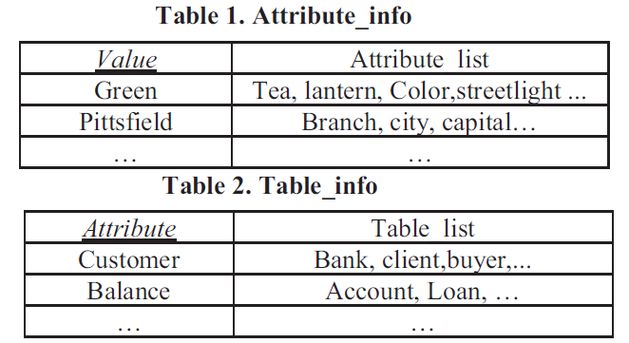
Inverted Index
The inverted index rephrases the relational database by associating every value to its corresponding column name and table name.

Slide 21
Thesaurus
While constructing an English statement query, user shouldn’t be restricted to the terminologies comprising of attributes and table names
‘address’ synonym: ‘living’
used by the user to represent the meta-data information.

Slide 22
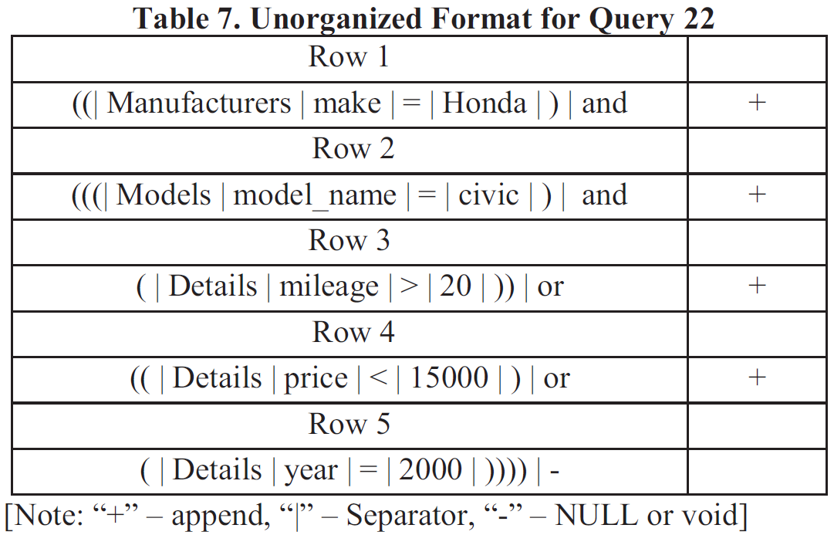
Constructing SQL Clauses
Unorganized format

Slide 23
Constructing SQL Clauses
Unorganized format
SQL format

Slide 24
Outline
Introduction
High Level Architecture
Query Parsing
Delimiters
CFG Grammar
SQL Query Construction
Resolving Ambiguity
Grouping Algorithm
Constructing SQL Clauses
Experiment
Conclusion

Slide 25
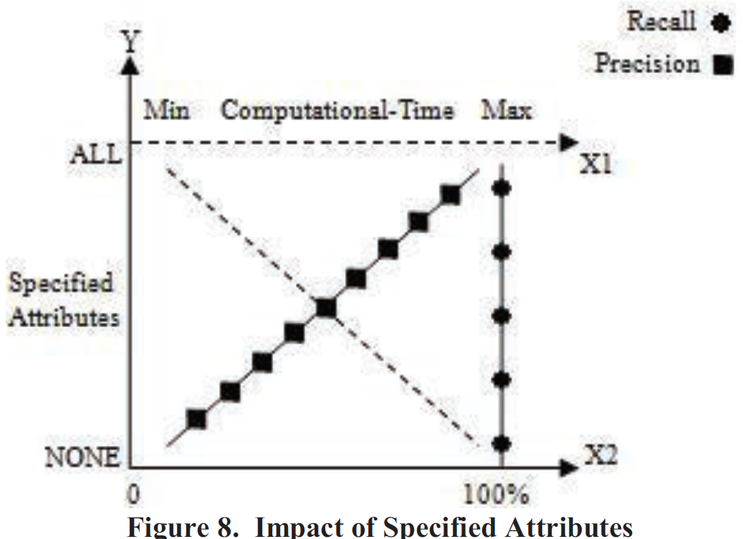
Experiment
X1-axis represents the time factor for query computation
X2-axis denotes the percentage value for recall and precision
Y-axis represents number of values in the given query for which the attributes are specified explicitly

Slide 26
Outline
Introduction
High Level Architecture
Query Parsing
Delimiters
CFG Grammar
SQL Query Construction
Resolving Ambiguity
Grouping Algorithm
Constructing SQL Clauses
Experiment
Conclusion

Slide 27
Conclusion
Paper points out the intrinsic limitation of keyword search in databases due to its lack of dealing with semantics.
The user can simply use the English language statements to retrieve the desired results for STRUCT system.
By employing a relatively simple parsing technique (Context Free Grammar ) and developing a grouping algorithm which incorporates contextual information obtained from user queries.

Slide 28
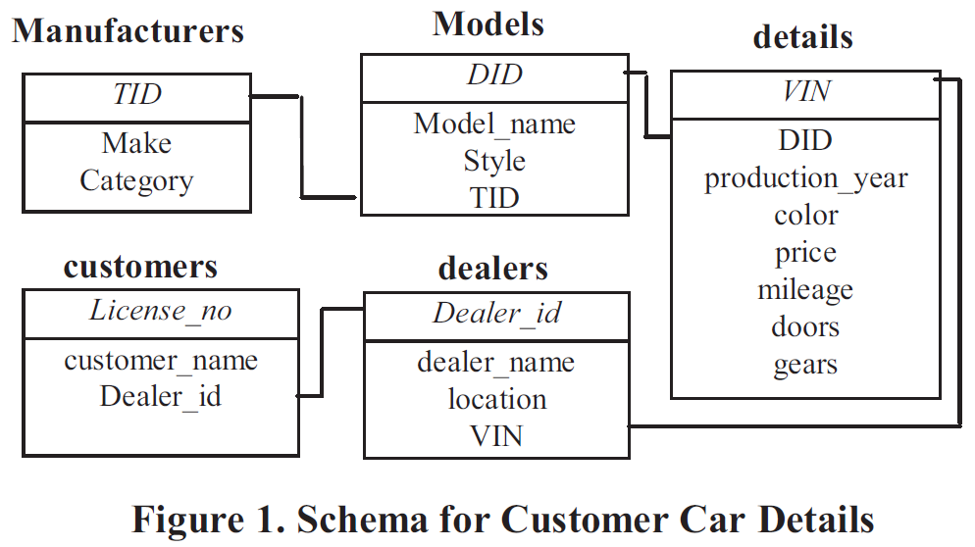
Schema

Slide 29
Resolving the Ambiguity
Query 10: Find cars having color White or Black and price < $3000
Parenthesized format: (color = White or color = Black) and (price < 3000)
Query 11: Find cars having red AND green color.
Parenthesized format: (color = red or color= green).
Query 12: Find a car which does not have mileage < 20 and price > 20000
Parenthesized format: ~ (mileage < 20 and price > 2000).
Query 13: Find any car but not Honda and should not be Red in color
Parenthesized format: ~ (Honda) and ~(Red).

Slide 30
